Slide 1
Week 3 Recap

Slide 2



Relational
DATABASES
Non-relational
DATABASES

Slide 3

IRONHACK BOOTCAMP
Relational vs. Non-relational
Structured Data
Information stored in several related tables
Fixed scheme
SQL
Unstructured Data
Information stored in a single table
No fixed scheme
No SQL

Slide 4
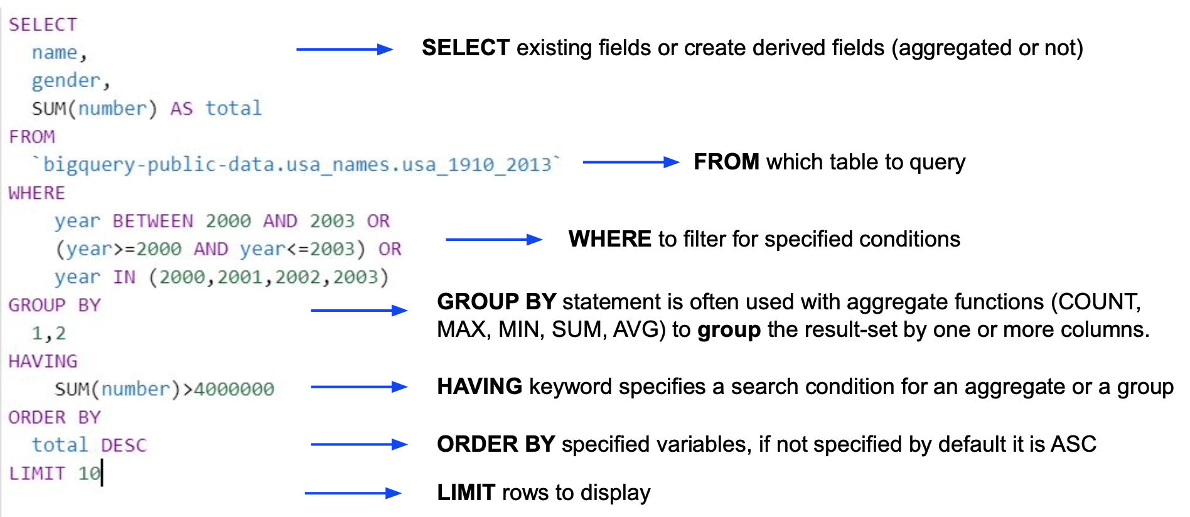
SQL query components

Slide 5
SQL query components
ARITHMETIC OPERATORS | +, - , *, /, %,
SELECT loan_id, account_id, duration, status, (amount - payments)/1000 AS ‘Balance in thousands’ FROM bank.loan;
LOGICAL OPERATORS | AND, OR
SELECT * FROM bank.loan
WHERE status NOT IN (‘B’,’b’) AND amount > 100000;
COMPARISON OPERATORS | <, >, >=, <=, <>
SELECT * FROM bank.loan
WHERE status NOT IN (‘B’,’b’) AND amount <> 100000;

Slide 6
IRONHACK BOOTCAMP
DISTINCT
This command allow us to get the unique values from a columns as “unique()” function from Pandas.
SELECT DISTINCT A3 FROM bank.district;

Slide 7
IRONHACK BOOTCAMP
IN
This command allow us to check for multiple values in a “list”
SELECT * FROM bank.account
WHERE district_id IN (1,2,3,4,5);

Slide 8
IRONHACK BOOTCAMP
AGGREGATION FUNCTIONS with Group By
To compute aggregated values by group:
sum() , min() , max() , avg(), count()
select avg(amount) from bank.loan
group by status;

Slide 9
IRONHACK BOOTCAMP
SORTING | ORDER BY
To sort the output, you can use ORDER BY col, which by default sorts in ascending order
SELECT distinct A2 FROM bank.district
WHERE A2 IN (‘Benesov’,’Beroun’) OR A4 < 75000
ORDER BY A4
LIMIT 10;
Default ordering can be changed appending DESC;
SELECT distinct A2 FROM bank.district
WHERE A2 IN (‘Benesov’,’Beroun’) OR A4 < 75000
ORDER BY A4 DESC
LIMIT 10;

Slide 10
IRONHACK BOOTCAMP
Built-in Functions
NUMERIC FUNCTIONS | COUNT(), MIN(), MAX(), AGV(), FLOOR(), CEILING()
E.g. SELECT floor(avg(amount)) FROM bank.order;
STRING FUNCTIONS | LENGTH(), CONCAT(), FORMAT(), LOWER(), UPPER(), LEFT(), XTRIM(), SUBSTRING(), SUBSTRING_INDEX()
E.g. SELECT *, LEFT(A2, 2), A3, LTRIM(A3) FROM bank.card;
E.g. SELECT SUBSTRING(‘Hello world’,7,1) -> ‘w’

Slide 11
IRONHACK BOOTCAMP
LIKE
This command allows to search for column values which have a “pattern” called “mask”.
It has two “wildcards”:
% -> zero, one or multiples characters
_ -> single character
SELECT * FROM bank.district
WHERE A3 LIKE ‘north%’;
SELECT * FROM bank.district
WHERE A3 LIKE ‘north_M%’;

Slide 12
IRONHACK BOOTCAMP
REGEXP (ReGularExpressions)
This term encapsulates a whole set of wildcards in order to look for patterns in strings.
The way to look for regular expressions is typing “regexp” and pattern you are looking for. Some “regex” popular patterns are:
‘^’ -> beginning of the string
‘$’ -> end of the string
‘|’ -> OR
SELECT * FROM bank.district WHERE A2 regexp '^B';
SELECT * FROM bank.district WHERE A2 regexp 'ov$';
SELECT distinct k_symbol FROM bank.order WHERE k_symbol regexp ‘ip|is’

Slide 13
Relational Database Model

Slide 14
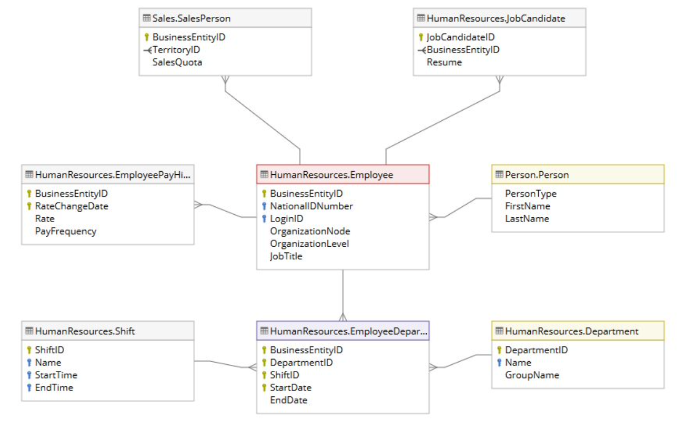
DataBase model/Diagram (ERD)
Entity Relationship Diagram

Slide 15
IRONHACK BOOTCAMP
LINKING TABLES: PRIMARY AND FOREIGN KEY
PRIMARY KEY:
is a unique identifier for every row of in a table
it can consists of a single or multiple columns of the table
EVERY TABLE must have a PRIMARY KEY
FOREIGN KEY:
is a key column to link two tables together
Is the common column of another table
It serves to enforce data consistency, as you can add rows to the child table if they are not defined in the parent table

Slide 16
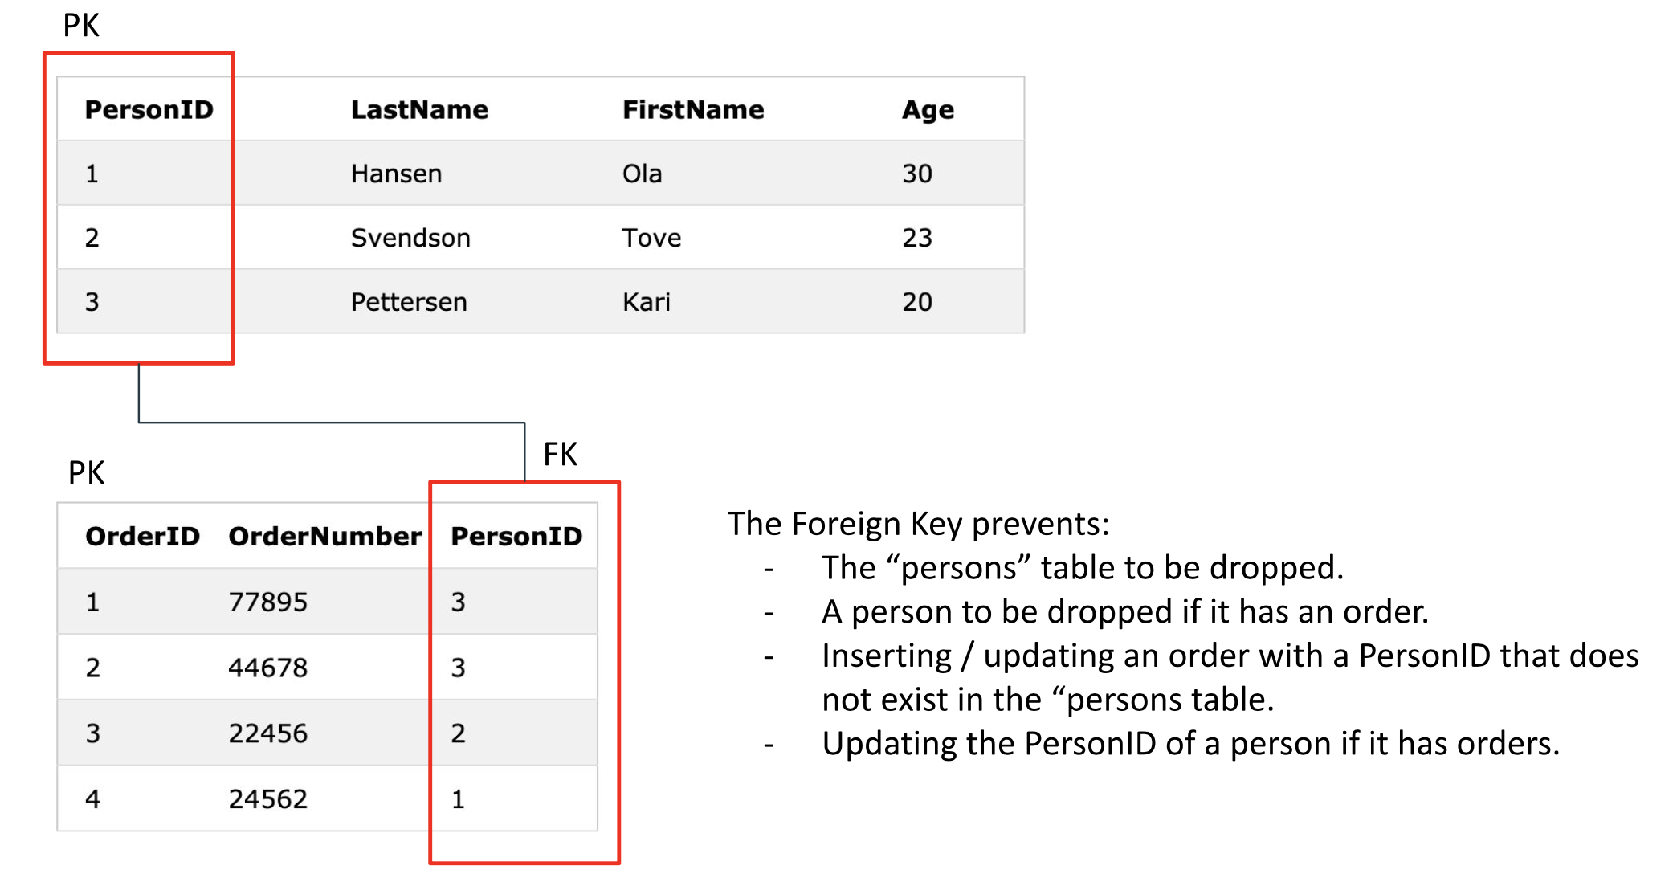
IRONHACK BOOTCAMP
PRIMARY AND FOREIGN KEY EXAMPLE

Slide 17
Joins

Slide 18





Types of Joins
Types of joins
Inner Join
Left Join
Full Join
Right Join

Slide 19
IRONHACK BOOTCAMP
JOIN SYNTAX
Join syntax is:
SELECT ta.col_n, …., t_b.col_m FROM table_a AS ta
TYPEOF JOIN table_b AS tb
ON ta.col_x = tb.col_y
Where TYPEOF = (INNER, LEFT, RIGHT, FULL)

Slide 20
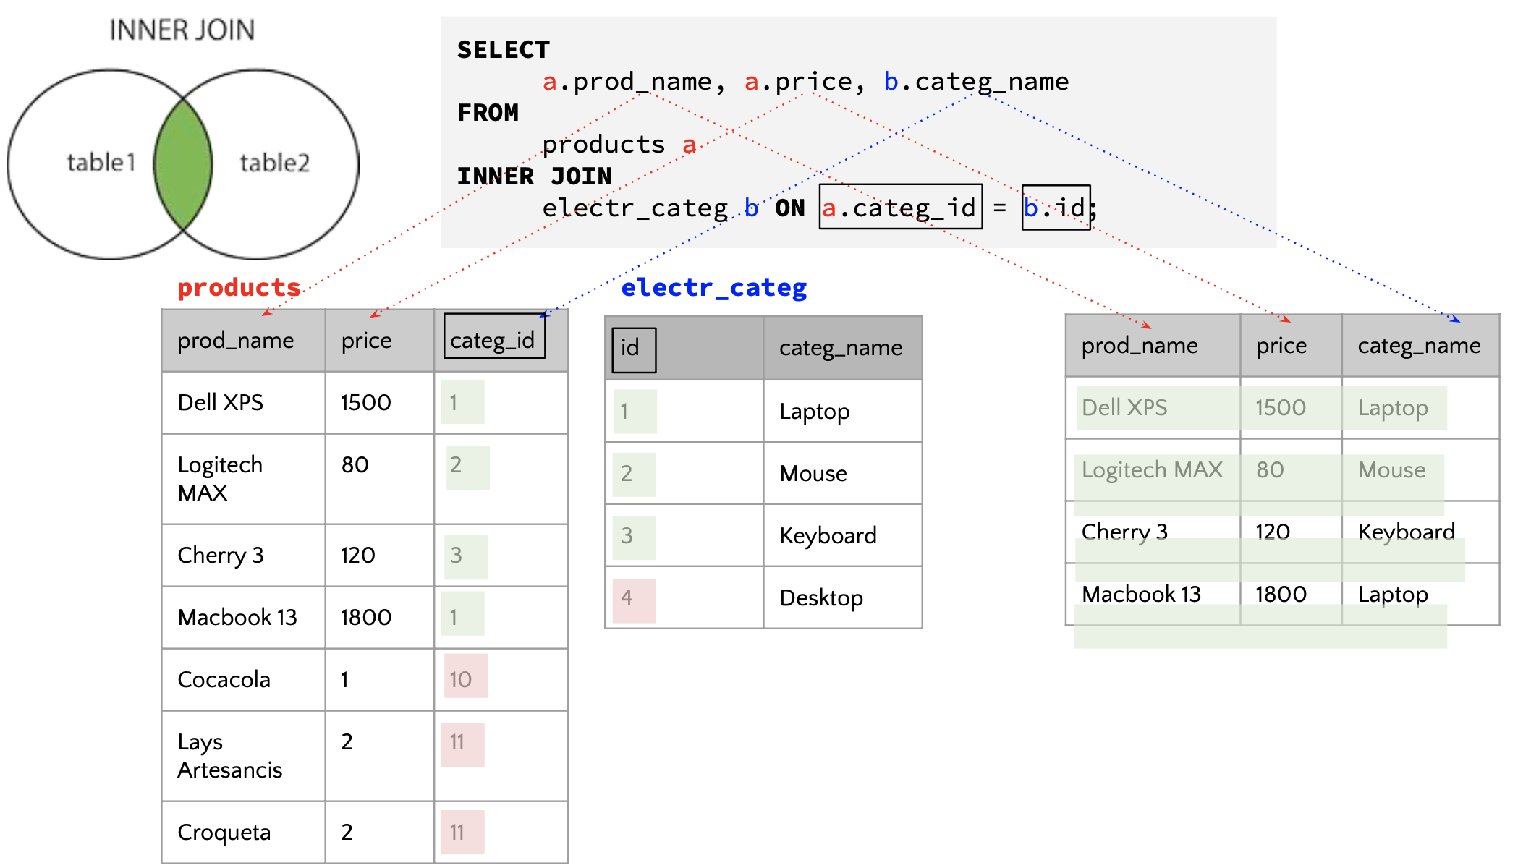
IRONHACK BOOTCAMP
INNER JOIN EXAMPLE

Slide 21
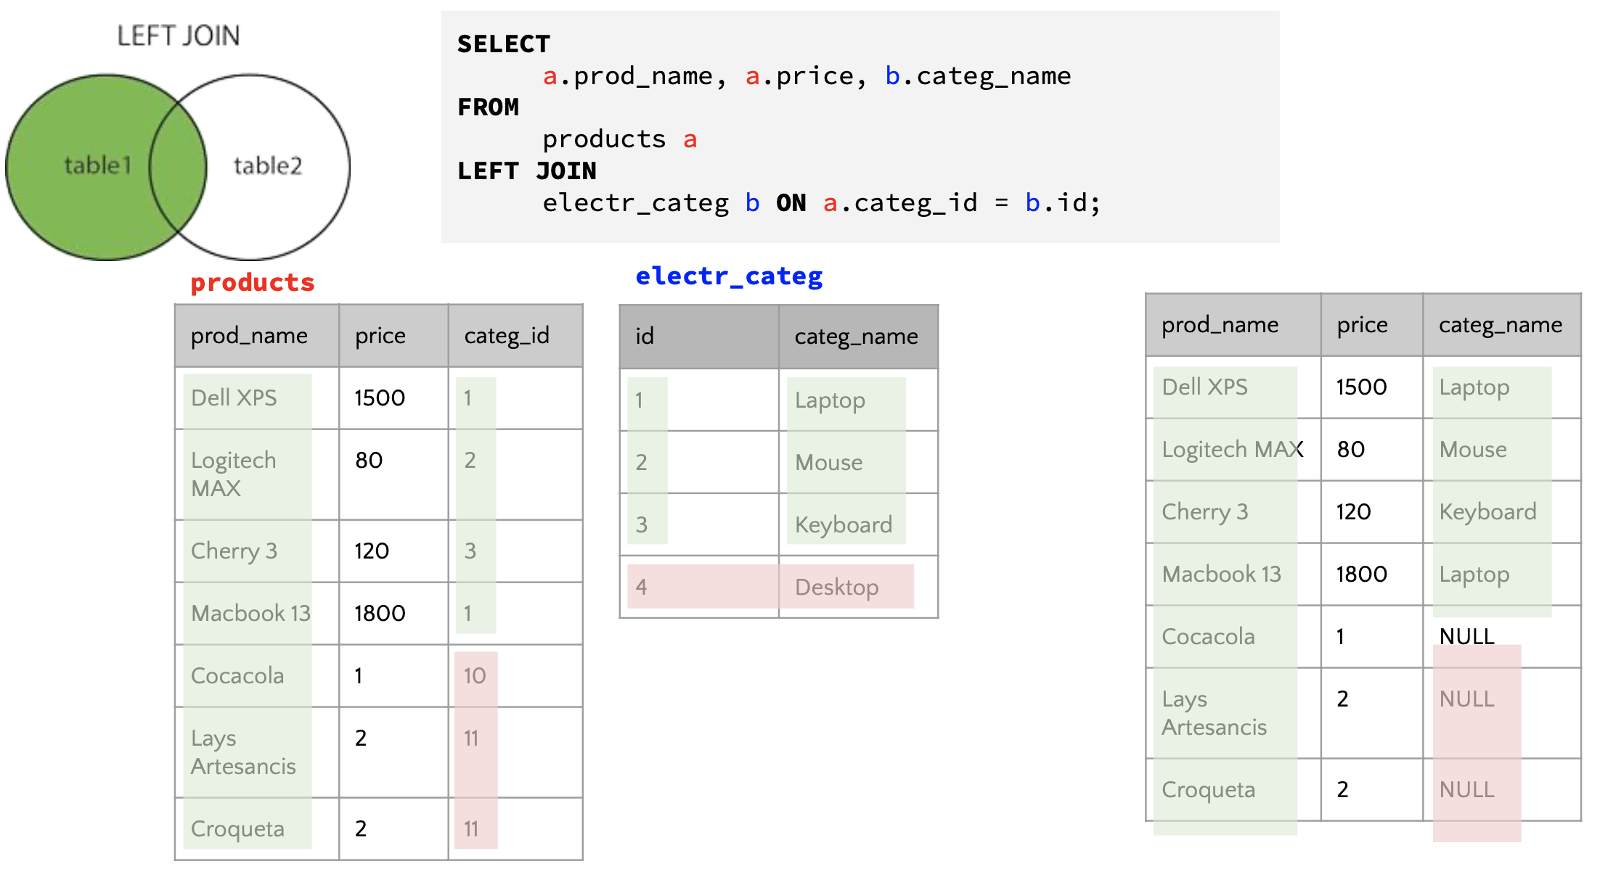
IRONHACK BOOTCAMP
LEFT JOIN EXAMPLE

Slide 22
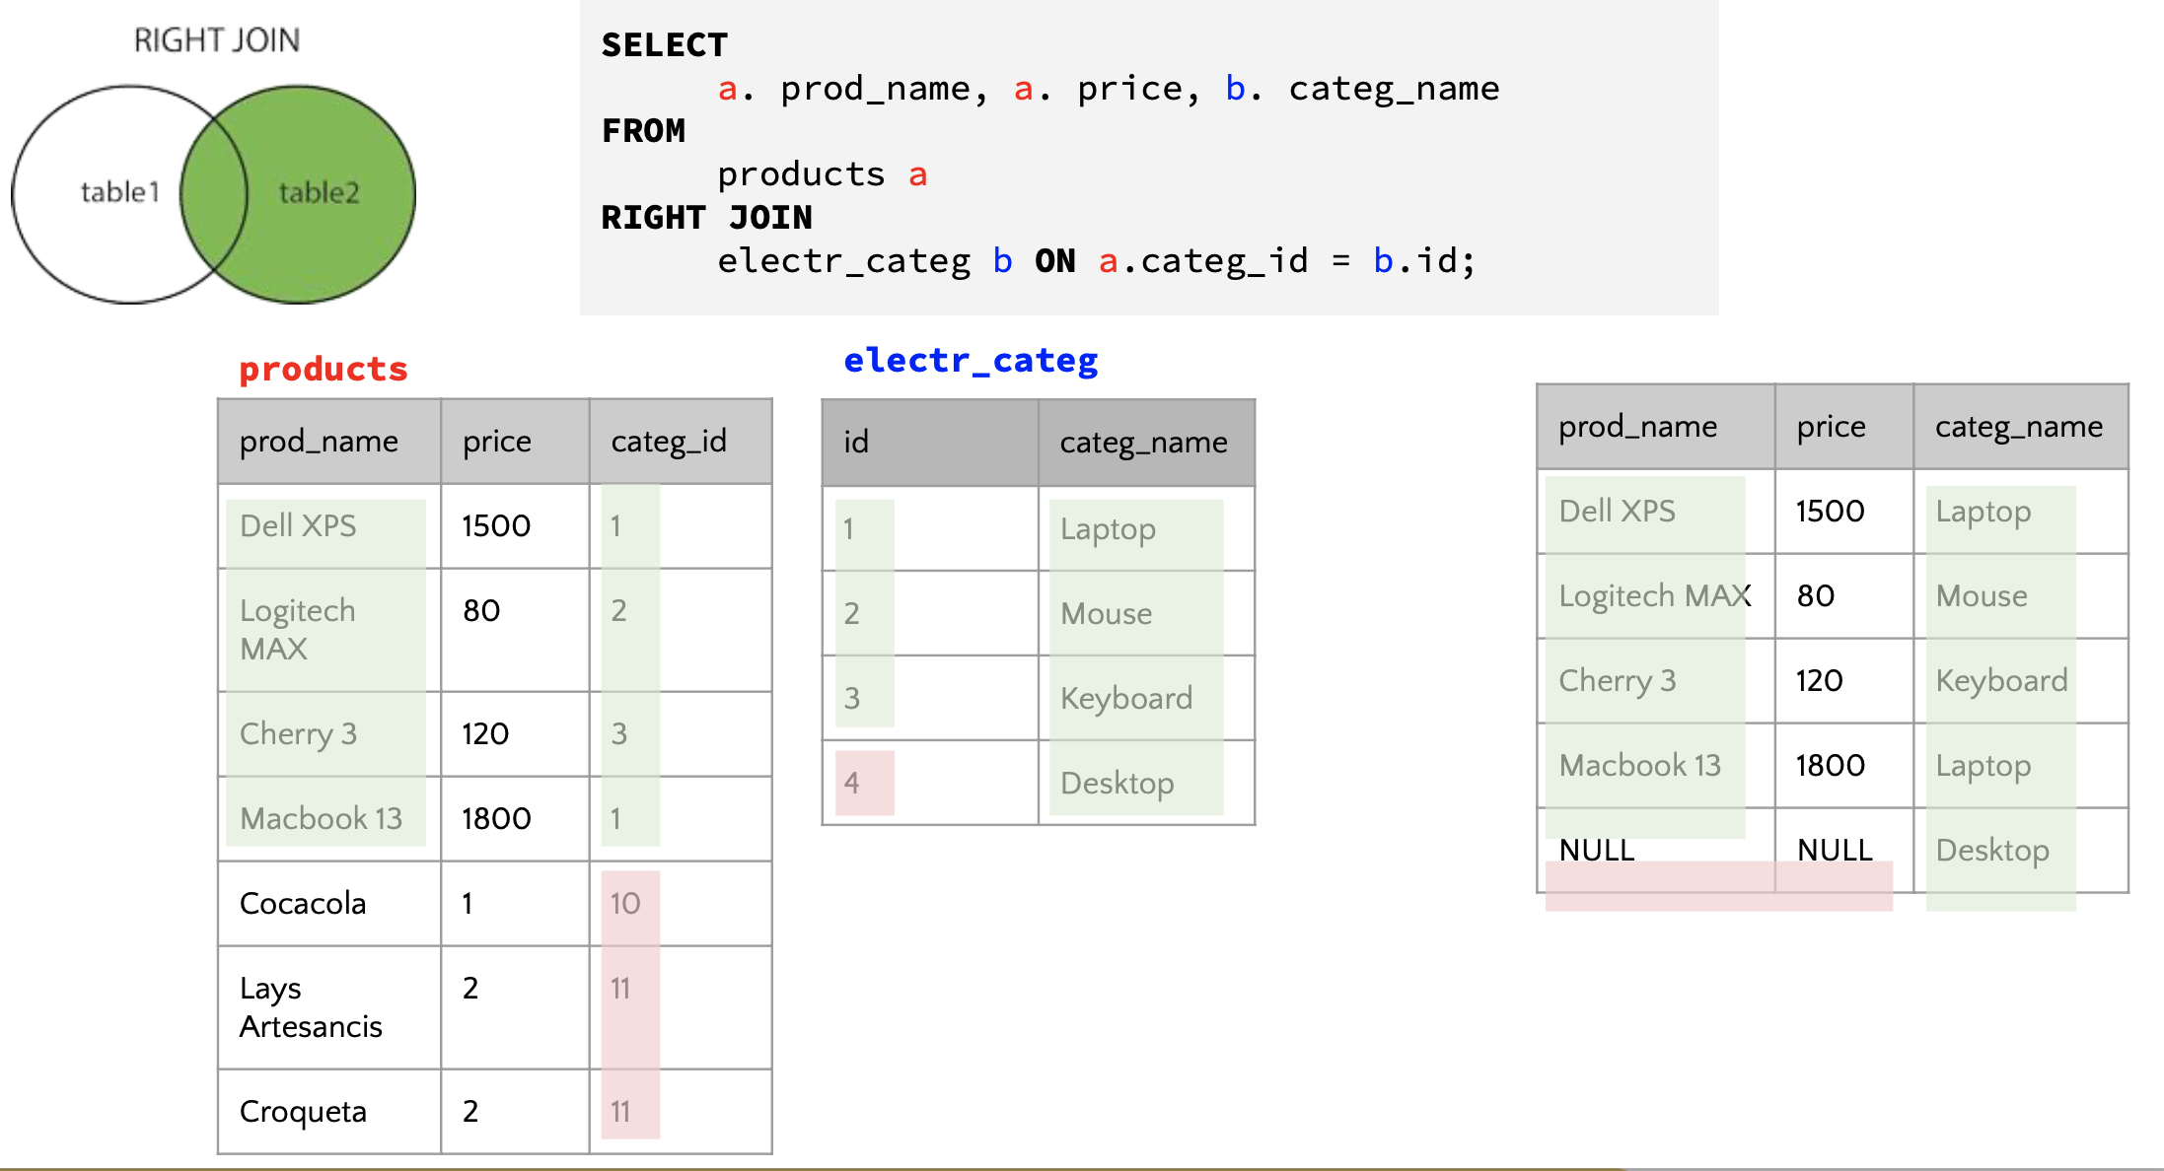
IRONHACK BOOTCAMP
RIGHT JOIN EXAMPLE

Slide 23
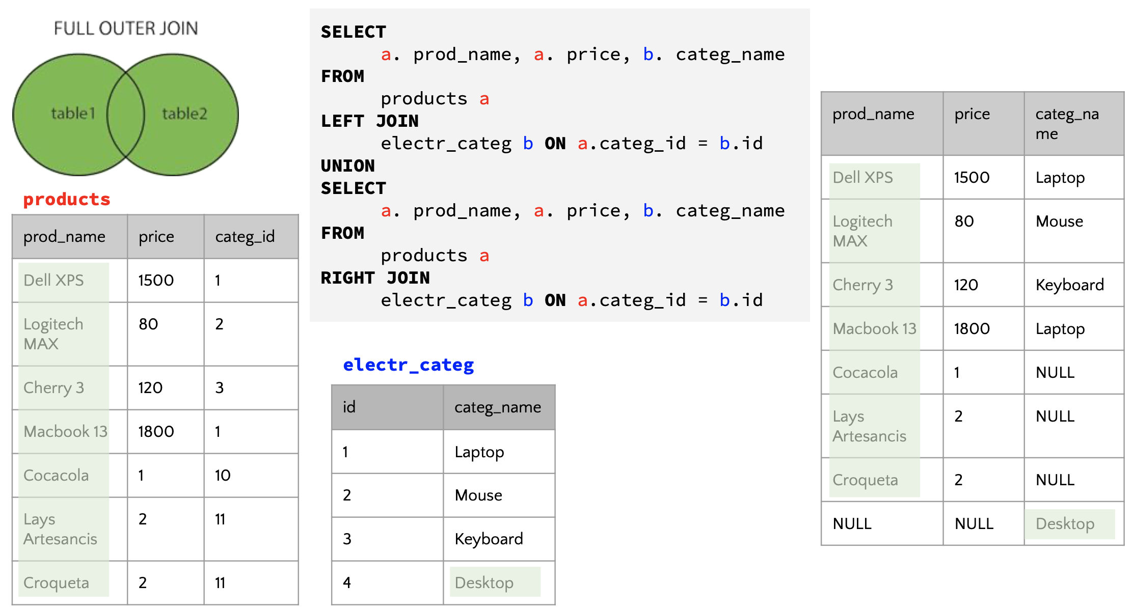
IRONHACK BOOTCAMP
FULL JOIN EXAMPLE

Slide 24
Subqueries

Slide 25
IRONHACK BOOTCAMP
WHAT IS A SUBQUERY?
A query that used by another query (without saving the output)
Rules:
A subquery can return a single value, a list of values or a table.
It can be many levels of subqueries.
The results of a subqueries can’t be included in the SELECT statement of the main query.

Slide 26
IRONHACK BOOTCAMP
EXAMPLE
Get the customers for which the borrowed amount is higher than the mean amount of all the customers.
-- step 1: calculate the average
select avg(amount) from bank.loan;
-- step 2 --> pseudo code the main goal of this step ....
select * from bank.loan
where amount > "AVERAGE";
-- step 3 ... create the query
select * from bank.loan
where amount > (
select avg(amount)
from bank.loan
);

Slide 27
IRONHACK BOOTCAMP
EXAMPLE
select operation from (
select operation, round(avg(balance),2) as Avg_balance from bank.trans
where k_symbol in (
select k_symbol as symbol from (
select k_symbol, round(avg(amount),2) as Average from bank.order
where k_symbol <> ' '
group by k_symbol
having Average > 3000
order by Average desc
) sub1
)
group by operation
) sub2
order by Avg_balance
limit 1;

Slide 28

Temporary tables.
DATA ANALYTICS | IRONHACK

Slide 29
IRONHACK BOOTCAMP
WHAT ARE THE TEMPORARY TABLES?
They are tables which contain some results that you use often, and you want to store.
Usually, they are made of sophisticated queries involving several joins.
They allow you to see the “progress” of advanced query.
MySQL removes the temporary table automatically when the session ends or the connection is terminated.

Slide 30
IRONHACK BOOTCAMP
EXAMPLE
create temporary table bank.loan_and_account
select l.loan_id, l.account_id, a.district_id, l.amount, l.payments, a.frequency
from bank.loan l
join bank.account a
on l.account_id = a.account_id;
select * from bank.loan_and_account;

Slide 31
Views

Slide 32
IRONHACK BOOTCAMP
Create View
a view is a virtual table based on the result-set of an SQL statement.
CREATE [OR REPLACE]
VIEW view_name [(column_list)]
AS select_statement
[WITH [CASCADED | LOCAL] CHECK OPTION]

Slide 33
DDL

Slide 34
IRONHACK BOOTCAMP
CREATING DATABASES
A MySQL database is basically a collection of tables.
A database can be created with the command: CREATE DATABASE name: Ex:
CREATE DATABASE IF NOT EXISTS books;

Slide 35
IRONHACK BOOTCAMP
COLLATION AND CHARACTER SET
Any new database needs to be defined using a:
Character set: which are the allowed characters
Collation: the combinations rules of the characters
The most common character set is: utf8mb4, for which the best collation is: utf8mb4_0900_ai_ci;
CHARACTER SET utf8mb4 COLLATE utf8mb4_0900_ai_ci
Read here for more

Slide 36
IRONHACK BOOTCAMP
CREATING TABLES
The syntax to create a table is:
CREATE TABLE [ IF NO EXISTS ] table_name (
colname1 type [options],
colname2 type [options],
colname3 type [options],
….
);
Where [IF NOT EXISTS] is optional and [options] can be any of:
AUTO_INCREMENT
PRIMARY KEY

Slide 37
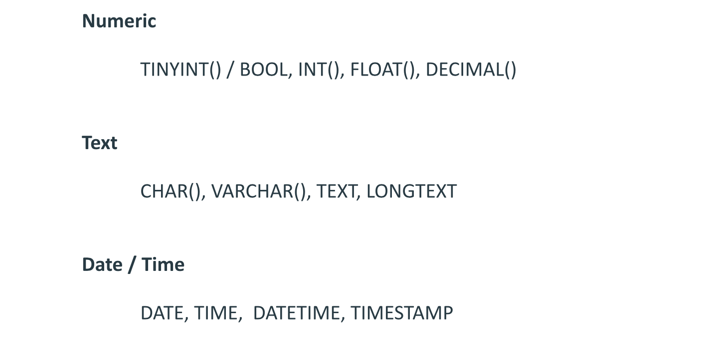
IRONHACK BOOTCAMP
MAIN DATA TYPES
Full data types

Slide 38
IRONHACK BOOTCAMP
ALTER TABLE Statement
ALTER TABLE tbl_name
[alter_option [, alter_option] ...]
[partition_options]
alter_option: {
table_options
| ADD [COLUMN] col_name column_definition
[FIRST | AFTER col_name]
| ADD [COLUMN] (col_name column_definition,...)
| ADD {INDEX | KEY} [index_name]
[index_type] (key_part,...) [index_option] ...
| ADD {FULLTEXT | SPATIAL} [INDEX | KEY] [index_name]
(key_part,...) [index_option] ...
| ADD [CONSTRAINT [symbol]] PRIMARY KEY
[index_type] (key_part,...)
[index_option] ...
| ADD [CONSTRAINT [symbol]] UNIQUE [INDEX | KEY]
[index_name] [index_type] (key_part,...)
[index_option] ...
| ADD [CONSTRAINT [symbol]] FOREIGN KEY
[index_name] (col_name,...)
reference_definition
| ADD [CONSTRAINT [symbol]] CHECK (expr) [[NOT] ENFORCED]
| DROP {CHECK | CONSTRAINT} symbol
| ALTER {CHECK | CONSTRAINT} symbol [NOT] ENFORCED
| ALTER [COLUMN] col_name {
SET DEFAULT {literal | (expr)}
| SET {VISIBLE | INVISIBLE}
| DROP DEFAULT
}

Slide 39
IRONHACK BOOTCAMP
ALTER TABLE Statement Cont.
table_options
| ALTER INDEX index_name {VISIBLE | INVISIBLE}
| CHANGE [COLUMN] old_col_name new_col_name column_definition
[FIRST | AFTER col_name]
| [DEFAULT] CHARACTER SET [=] charset_name [COLLATE [=] collation_name]
| CONVERT TO CHARACTER SET charset_name [COLLATE collation_name]
| {DISABLE | ENABLE} KEYS
| {DISCARD | IMPORT} TABLESPACE
| DROP [COLUMN] col_name
| DROP {INDEX | KEY} index_name
| DROP PRIMARY KEY
| DROP FOREIGN KEY fk_symbol
| FORCE
| LOCK [=] {DEFAULT | NONE | SHARED | EXCLUSIVE}
| MODIFY [COLUMN] col_name column_definition
[FIRST | AFTER col_name]
| ORDER BY col_name [, col_name] ...
| RENAME COLUMN old_col_name TO new_col_name
| RENAME {INDEX | KEY} old_index_name TO new_index_name
| RENAME [TO | AS] new_tbl_name
| {WITHOUT | WITH} VALIDATION
}

Slide 40
DML

Slide 41
IRONHACK BOOTCAMP
LOADING DATA INTO A TABLE: INSERT COMMAND
This command is used to insert records in a table.
The syntax is the following:
INSERT INTO db.table values(...., …., …., ….);
The values inside the list should be provided in the same order as the columns.
The value types should match the column types

Slide 42
IRONHACK BOOTCAMP
LOADING DATA INTO A TABLE: LOAD DATA
This command is used to add data from a local file into a table:
LOAD DATA LOCAL INFILE '/path/pet.txt' INTO TABLE pet;
Pay attention to the field separator! By default, the field separator is a tab ‘\t’.

Slide 43
IRONHACK BOOTCAMP
DELETE COMMAND
This command is used to delete records in a table.
The syntax is the following:
DELETE FROM db.table WHERE condition;

Slide 44
Stored procedures and functions.
DATA ANALYTICS | IRONHACK

Slide 45
IRONHACK BOOTCAMP
STORED PROCEDURES: DEFINITION
A stored procedure is a set of SQL statements that can be stored in the server or in a local sql file.
Stored procedures usually contain repetitive queries.
Stored routines may call other stored procedures.

Slide 46
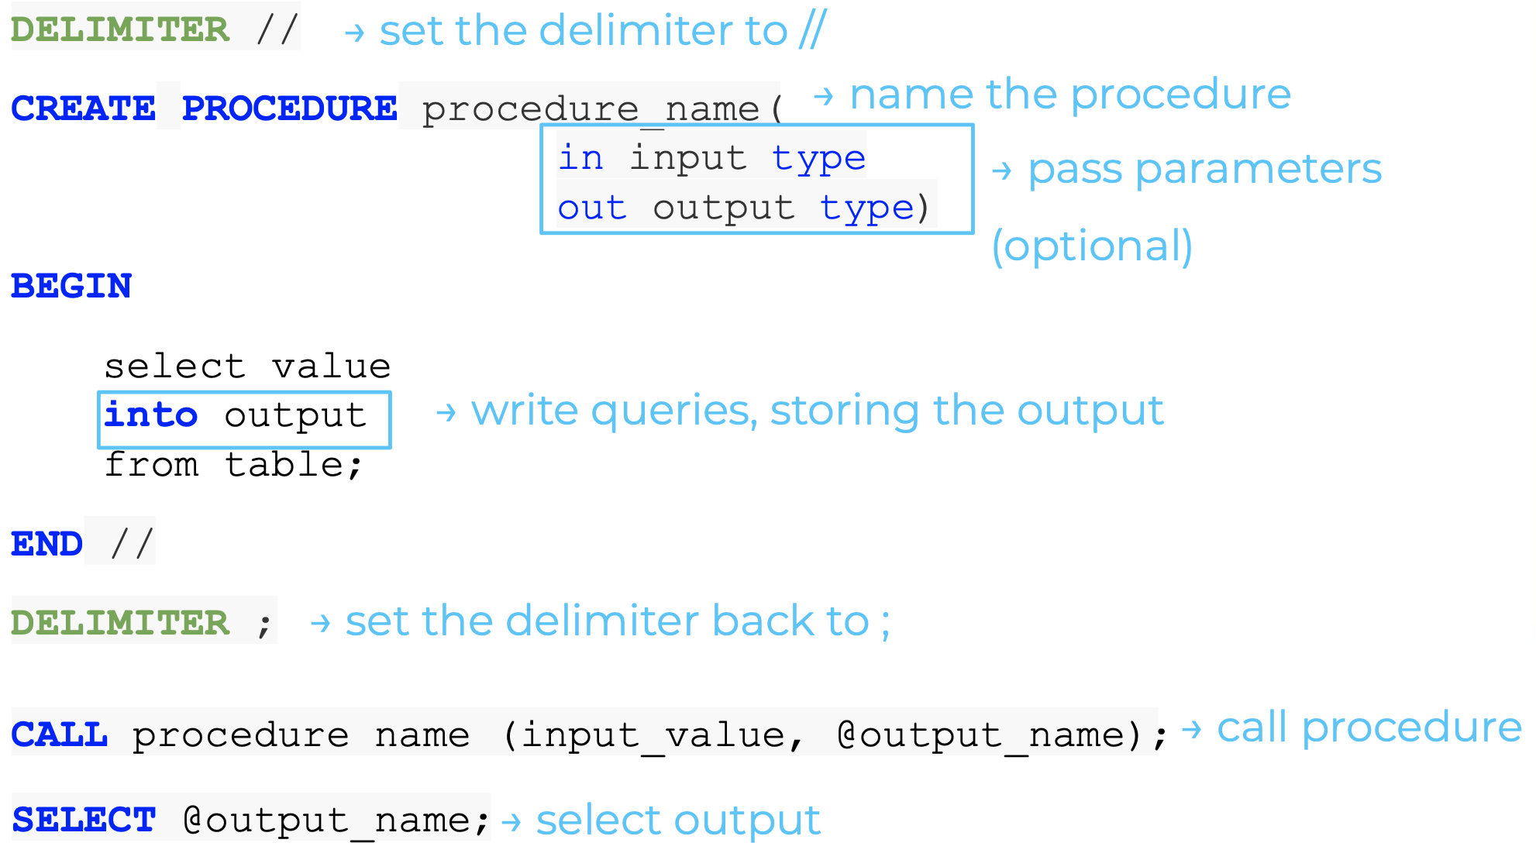
IRONHACK BOOTCAMP
SYNTAX

Slide 47
IRONHACK BOOTCAMP
NOTES:
The MySQL Stored procedure arguments can have three modes:
IN: the argument is an input
OUT: the stored procedure returns a final output in the argument
INOUT: the argument is used as INPUT and OUTPUT
To store the value returned by the procedure, pass a ‘session variable’ appending and “@” to the variable name:
To execute the procedure
CALL procedure_name(@variable)

Slide 48
IRONHACK BOOTCAMP
EXAMPLES.
We want to create a stored procedure that returns the number of rows in a table.
DELIMITER //
CREATE PROCEDURE number_of_rows_proc ( OUT param1 INT )
BEGIN
SELECT count(*) into param1 FROM bank.account;
END //
DELIMITER ;
// Calling the procedure
CALL number_of_rows_proc(@x);
Select @x

Slide 49
IRONHACK BOOTCAMP
FUNCTIONS
They are sets of commands that we want to use frequently.
create function function_name(var type)
returns type deterministic
return value
create function print_function (x char(20))
returns char(50) deterministic
return concat('Iron', x, '!');
select print_function('hack');

Slide 50
IRONHACK BOOTCAMP
PROCEDURES VS FUNCTIONS
To call them you need ‘CALL
Can have: inputs, outputs, in-outputs
Can perform several operations
You call them without ‘CALL’
Can have: inputs
Return a single value
They MUST contain a RETURN clause
Procedures vs functions

Slide 51
SELECT CASE statement
DATA ANALYTICS | IRONHACK

Slide 52
IRONHACK BOOTCAMP
UTILITY OF CASE STATEMENTS
Case statements are a way to replace the column values by new values
(ONLY WHEN DISPLAYED, not in the table)

Slide 53
IRONHACK BOOTCAMP
USING CASE STATEMENTS Example
SELECT loan_id, account_id ,
CASE
WHEN status = “A” THEN “Good - Contract finished”
WHEN status = “B” THEN “Defaulter - Contract finished”
WHEN status = “C” THEN “Good - Contract running”
ELSE “In debt - Contract running”
END AS “Status_Description”
FROM bank.loan;

Slide 54
Connecting Python with SQL
DATA ANALYTICS | IRONHACK

Slide 55
IRONHACK BOOTCAMP
LIBRARY LOADING and creating Connection
install the required libraries (Conda or pip)
pip install sqlalchemy
pip install PyMySQL
Load the required libraries:
import pymysql
from sqlalchemy import create_engine
import pandas as pd
import getpass # To get the password without showing the input
password = getpass.getpass()
To create the connection between Python and SQL:
connection_string = 'mysql+pymysql://root:' + password + '@localhost/bank'
engine = create_engine(connection_string)

Slide 56
IRONHACK BOOTCAMP
QUERYING A SQL DATABASE FROM PYTHON:
Once you started the engine, RUN:
result = db_connection.execute('SELECT * FROM loan')
for row in result:
print(row)
rows = [row for row in result]
pd.DataFrame(rows)

Slide 57
IRONHACK BOOTCAMP
QUERY A SQL DATABASE FROM PYTHON:
Once you started the engine, RUN:
DB_connection.execute("DROP DATABASE IF EXISTS BootCamps")
DB_connection.execute("CREATE DATABASE IF NOT EXISTS BootCamps")
DB_connection.execute("USE BootCamps")

Slide 58
IRONHACK BOOTCAMP
QUERY A SQL DATABASE FROM PYTHON:
You can import your queries into Pandas!
query = 'select order_id as "OrderID", account_id as "AccountID", bank_to as "DestinationBank", amount as "Amount" \
from bank.order \
where k_symbol = "SIPO" \
limit 100'
data = pd.read_sql_query(query, DB_connection)
data.head()

Slide 59

Data Storage and Processing
DATA ANALYTICS | IRONHACK
Notes:
Choosing other names

Slide 60
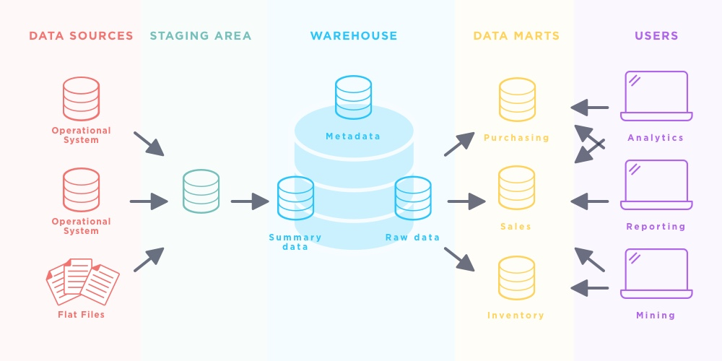
IRONHACK BOOTCAMP
Data Architecture | The data flow

Slide 61

IRONHACK BOOTCAMP
TYPES OF
DATA STORAGE
Data Lake
DBs
DWs
Data Marts
Data dump
Repository to store all kinds of data, in its natural format
Data storage system
Stores data in a structured format for easy retrieval
Database that integrates databases
for analytical purposes
Store data from DWs
to be used by a specific business function

Slide 62
Parameter | OLTP | OLAP
Transaction | Large number of short transactions | Small number of long transactions
Queries | Simple | Complex
Data Processing | Queries process small amounts of data | Queries process large amounts of data
Updates | Frequent | Infrequent
Data Epoch | Current | Historical
Model | Tables are normalized | Denormalized for simplicity
Purpose | Faster data storage and retrieval | Data mining
Topic Name | Graph Details

